Slide 1

세종대왕
Sejong the Great
Notes:
세종대왕
세종 the great

Slide 2
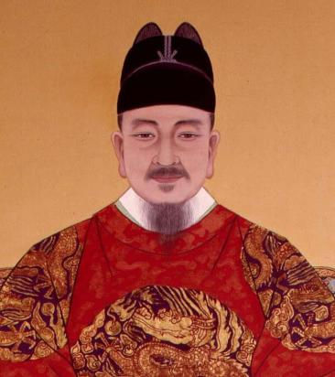
세종대왕
이름: 이 도
조선 제 4대왕
재위기간: 1418년 8월 (22세) – 1450년 2월 (53세)
취미: 공부, 책 읽기
특이 사항: 절대 음감, 토론, 경청
Notes:
세종대왕’s original name was ‘이도’. ‘세종’ was the name given to him by his successor in consideration of all his achievements, and ‘대왕’ means the great king. This title was given to kings for their many achievements. 세종 was the fourth king of 조선. He became king in 1418 at the age of 22 till the age of 53 in 1450. 세종's hobbies were studying and reading books. He was a king who liked to debate and listen. Fun fact, he also had perfect pitch.

Slide 3
과학적 발전
과학과 발명품에 대한 관심이 많았음
신분에 상관없이 다양한 인재들을 등용
농사, 무기, 의학 등 많은 분야에 적용
Notes:
세종대왕 was very interested in science and inventions. He gave opportunities to a variety of talented people, regardless of their status. As a result, achievements in many fields, such as agriculture, weapons, and medicine were made.

Slide 4
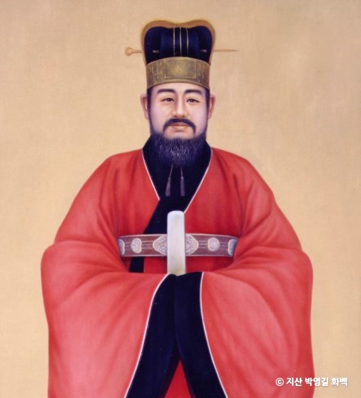
이름:장영실
세종대왕이 등용한 조선 최고의 발명가
노비 출신
앙부일구, 자격루 등 많은 발명품을 만듦
Notes:
This is 장영실. 세종대왕 knew 장영실's ability and talent and gave him a chance. 장영실 was one of the greatest inventors of 조선. There was a class system in 조선, so slaves could not rise to government posts, but thanks to 세종대왕, 장영실 who belonged to the slave class, was able to fully demonstrate his abilities. He made many inventions, such as a sundial and a water clock.

Slide 5
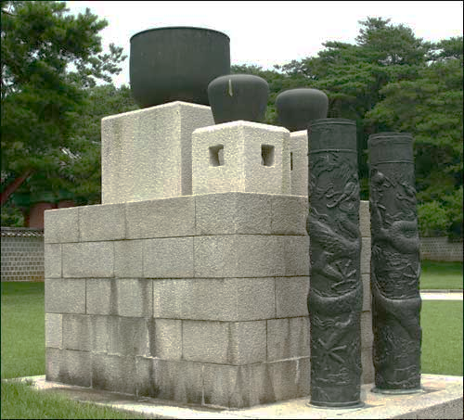
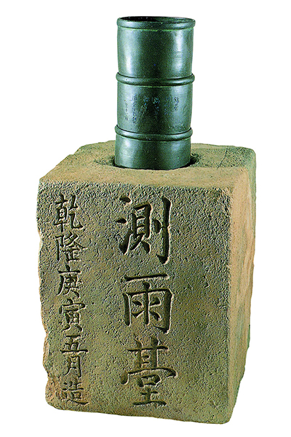
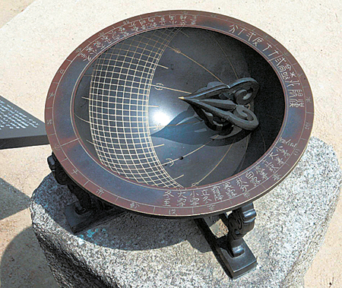
자격루
(물시계)
측우기
(Water Gauge)
앙부일구
(해시계)
Notes:
On the left is the water clock, 자격루. It is a watch made to tell time by making a sound by itself using flowing water. In the middle is the rain gauge, 측우기. It was made to measure and record the amount of rain in each province. It is the world's first rainfall gauge. On the right is the sundial, 앙부일구. It was placed in a public place so that the people could see it and know the time. For the people who did not know how to read, animal pictures were engraved on it to tell the time.

Slide 6
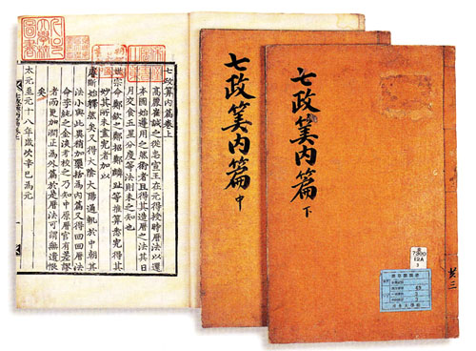
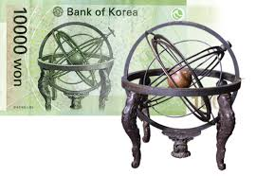
칠정산
Calendar Calculation
혼천의
Celestial Globe
Notes:
The picture on the left is 칠정산. It is a book that calculates the calendar to fit 조선. On the right is the astronomical observation instrument, 혼천의.

Slide 7
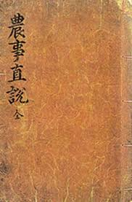
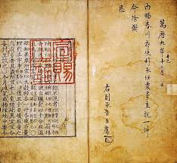
농사직설 – KOREAN AGRICUTURAL BOOK
Notes:
This book is 농사직설 about farming. 조선 was a country where agriculture was an important economic sector. Previously, it relied on Chinese agricultural books, but by the order of 세종대왕, this book was published based upon the experiences of excellent farmers from all over Korea. This book recorded farming methods suitable for Korea's climate.

Slide 8
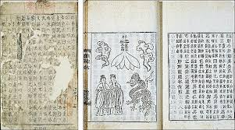
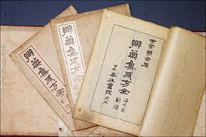
의방유취, 향약 집성방 – KOREAN MEDICAL BOOK
Notes:
These photos are medical books, 의방유취 ,향약집성방. These are books about diseases and treatments.

Slide 9
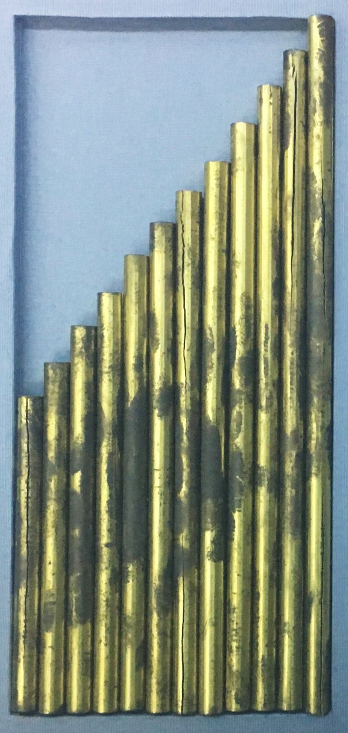
황종율관 Hwangjong pitch pipe
박연이 만듦
정확한 음의 기준이 되어 조선의 음악을 발전시킴
Notes:
세종 was also interested in music. This is 황종율관 that 박연 made by 세종’s order. The music of 조선 was then further developed.

Slide 10
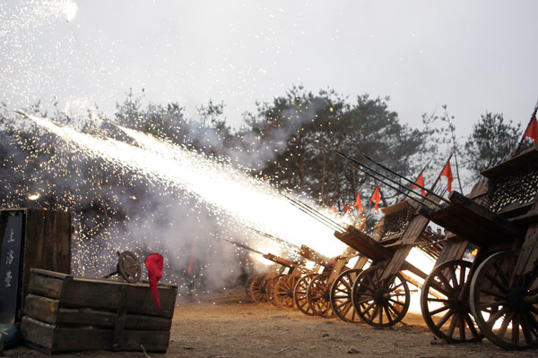
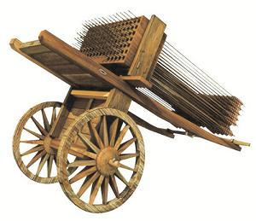
신기전 – KOREAN FIRE ARROW ROCKET
Notes:
This is a weapon, named 신기전. New weapons were developed in the era of 세종.

Slide 11
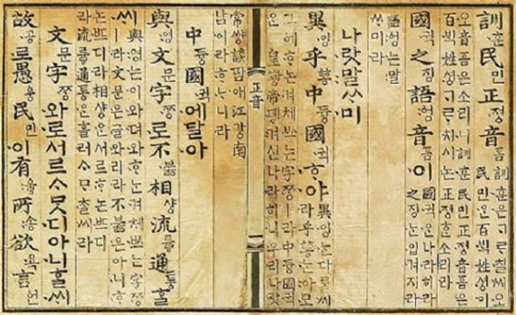
훈민정음
Notes:
Look at this picture, this picture is 훈민 정음. When 한글 was first created, the name was '훈민정음', not '한글'.

Slide 12
훈민
정음
백성을 가르치는
바른 소리
Notes:
‘훈민’ means teaching the people. ‘정음’ means right sound. 훈민정음 means ‘the right sound to teach the people’. The reason 세종대왕 created 한글, was his love for them.

Slide 13
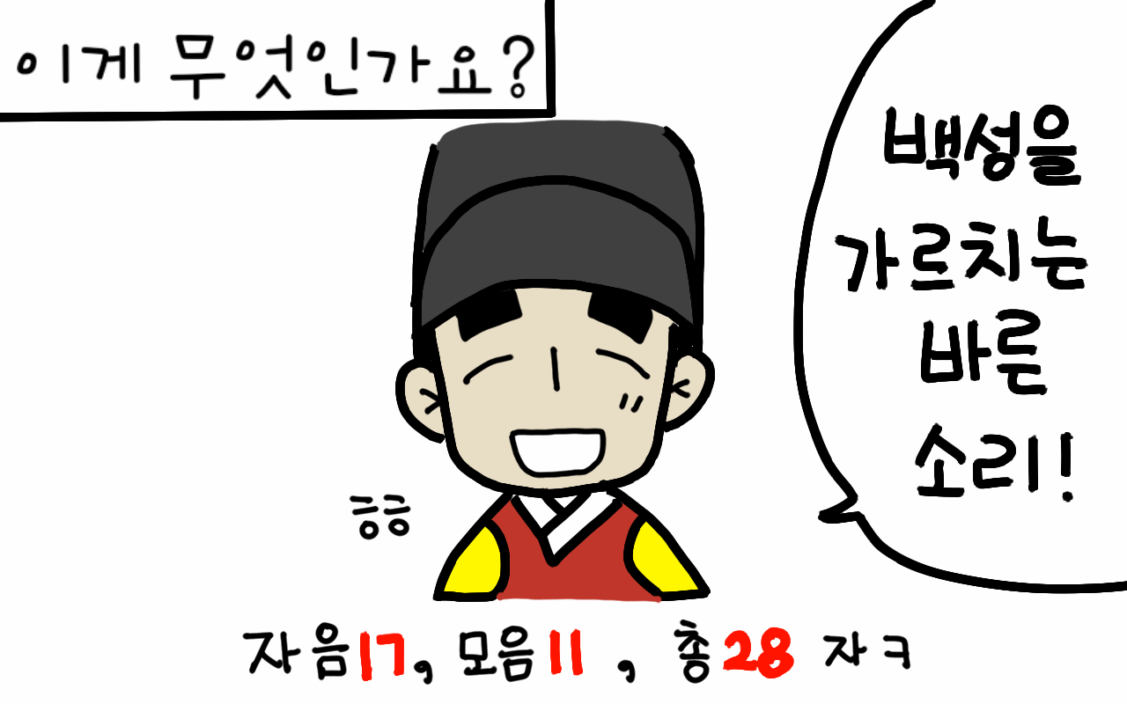
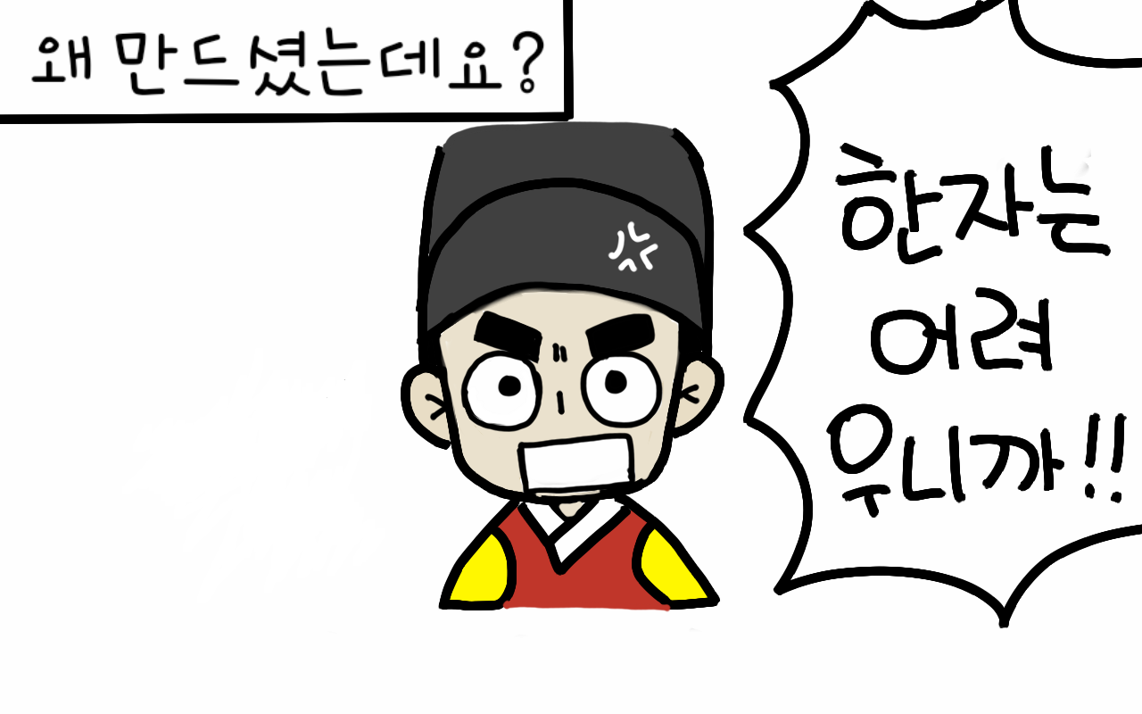
한자는 배우기가 어려워
많은 백성들은 글자를 몰랐음
Notes:
Until 훈민정음 was invented, Chinese characters were borrowed and used, but the people could not read and write because they could not study Chinese characters. 세종대왕, felt pity and created the scientific letters, 훈민정음 to teach the people.

Slide 14
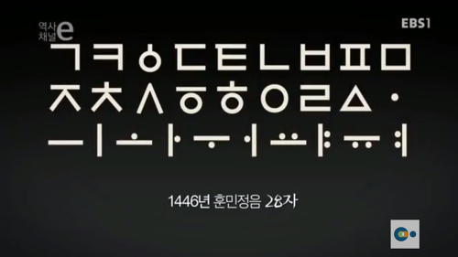
훈민정음이 처음 만들어졌을 때의 모양
Notes:
This is 훈민정음, when it was first created.

Slide 15
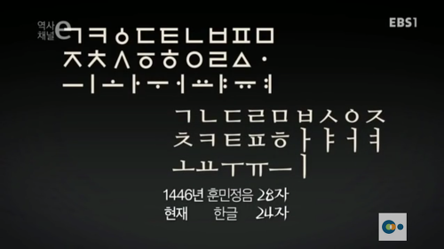
훈민정음 28자
현재 한글 24자
Notes:
훈민정음 had 28 characters, and now 한글 has 24 characters.

Slide 16
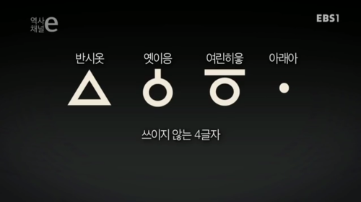
Notes:
These four letters are not currently used.

Slide 17
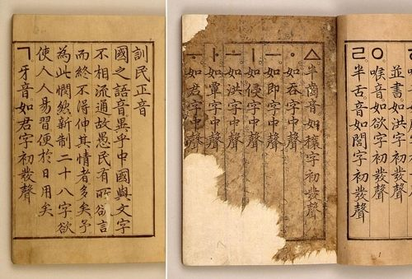
훈민정음 해례본
(Explanation and Examples)
Notes:
This photo is 훈민정음 해례본. This book explains in detail, the principles, process, and examples of the 28 훈민정음 characters.

